Slide 1
Regression by Eye
Replication of “Regression by Eye: Estimating Trends in Bivariate Visualizations” by
Michael Correll and Jeffrey Heer
Bianca Stancu | Alix d’Agostino | Natalia Obukhova | Tim Brlan | Alexander Pfyffer | Mathias Lüthi

Slide 2


Motivation & research question
Understand how different data visualizations bias the participants’ estimations
How do the type of chart, the bandwidth of the residuals and trend type affect the estimated trend of the bivariate visualization by an individual?
Notes:
Graphs are everywhere

Slide 3



Hypotheses
H1 - No bias in estimations from under- or overshooting
H2 - Larger residuals will result in less accuracy
H3 - The type of trend will have no statistically significant effect
Notes:
hypotheses swapped
h3 negated

Slide 4
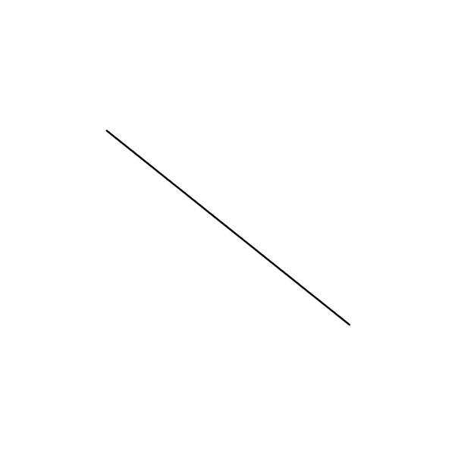
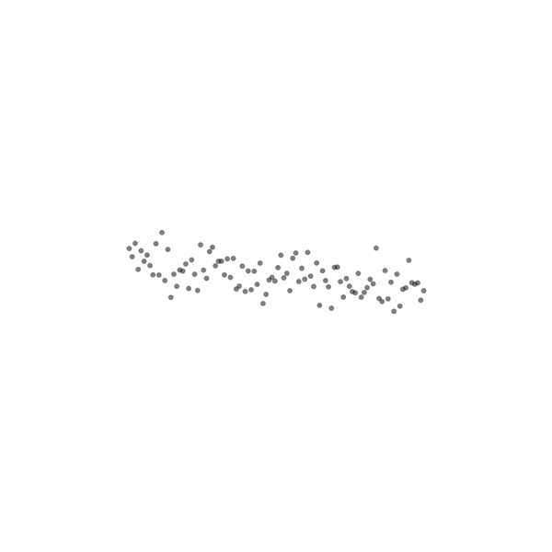
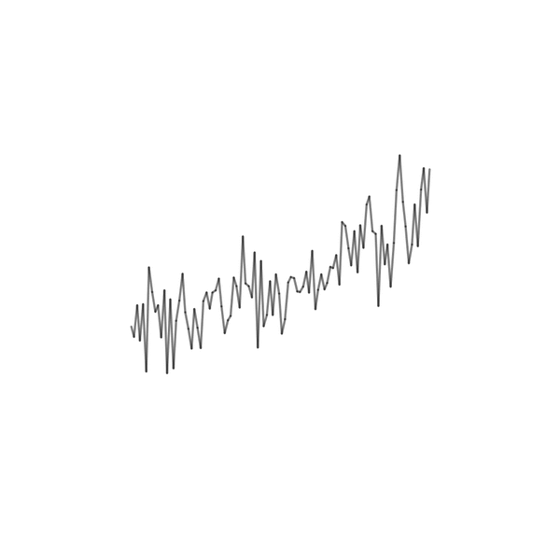
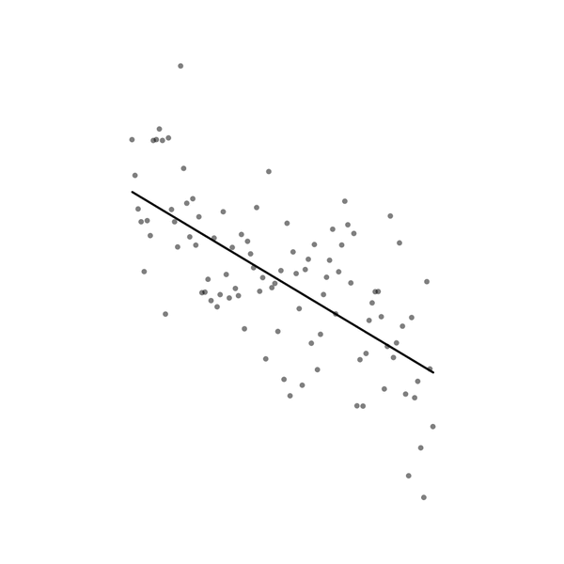
Experimental design
8 slopes
4 bandwidths of residuals
3 chart types
3 trend types
Notes:
How we construct one condition - 8 slopes * 4 br * 3 chart types (line, scatter, area) + randomly assigned trend type to each of the combinations (linear, quadratic, trigonometric) =
96 combinations

Slide 5
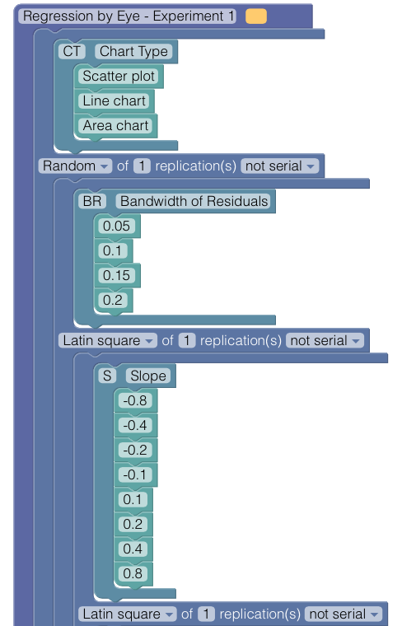
Experimental design
96 combinations
(incl. 32 randomly assigned trend types)
4 validation tasks (100 overall)
Suitable for multiple of 8 participants
16 participants → 100% effect coverage
Notes:
> 0.2 error -> participant eliminated

Slide 6









Participants
Age:
20-25: 11
26-29: 4
30+: 1
Gender:
Female: 8
Male: 8
Nationality:
Swiss: 13
Other: 3
Faculty:
PF: 7
OEC: 9
Level of education:
BA: 10
MA: 5
PhD: 1
Graphs once a month:
Yes: 11
No: 5
Read paper:
Yes: 0
No: 16
Visual impairments:
Yes: 0
No: 16
Computers once a week:
Yes: 16
No: 0
Notes:
Participant criteria

Slide 7
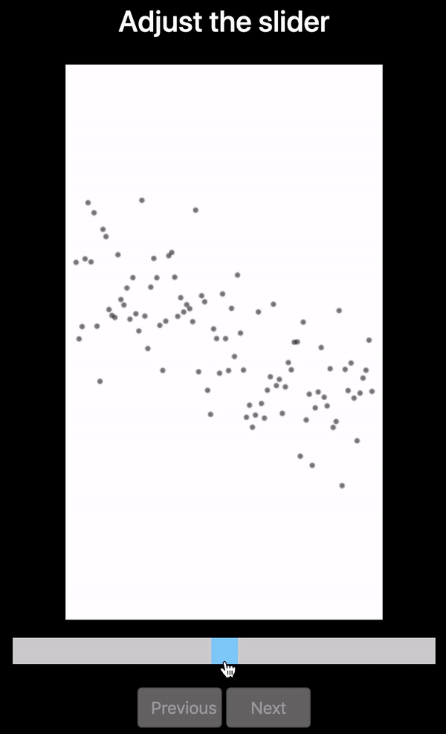
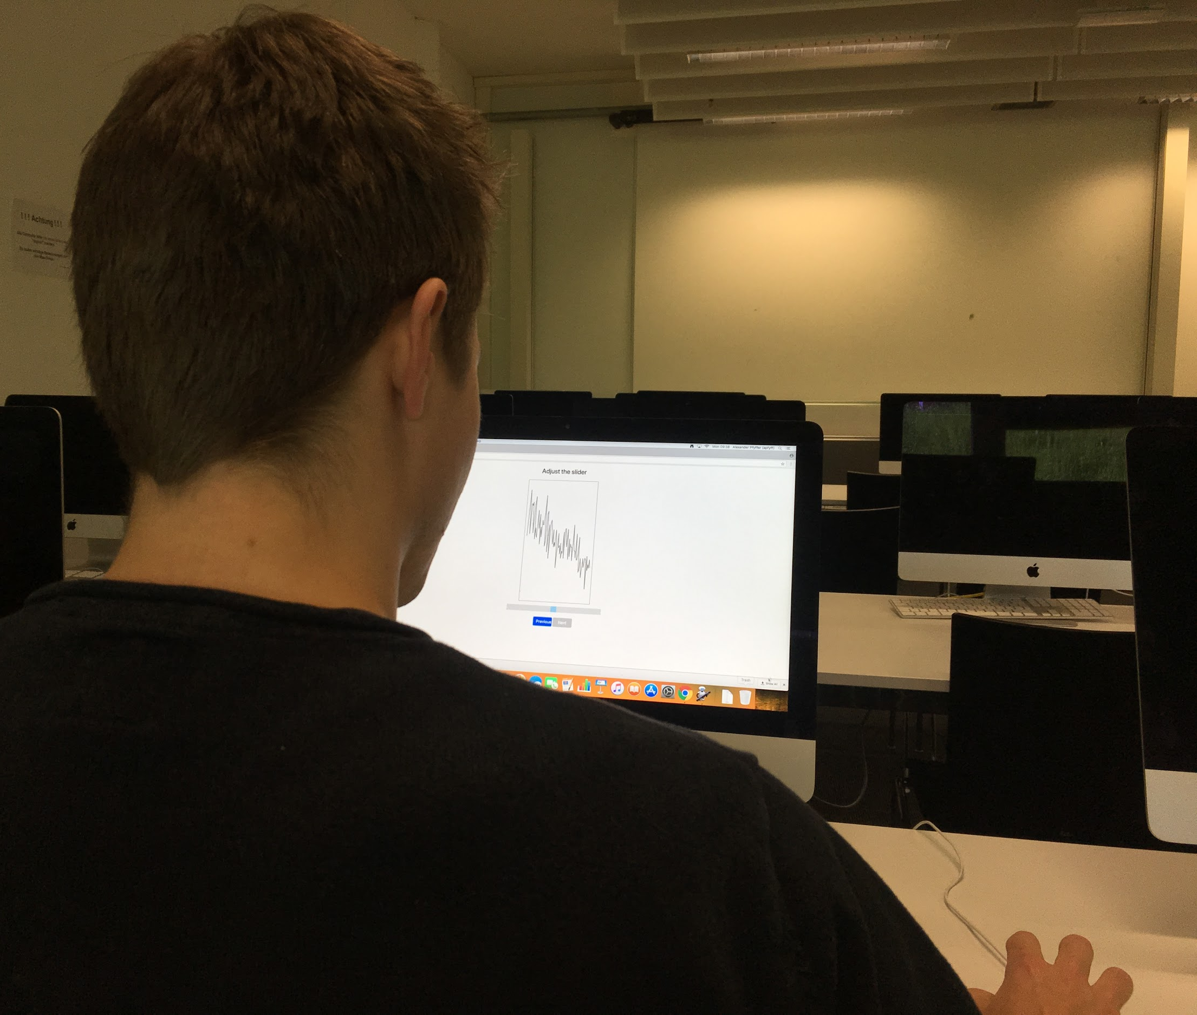
Software and tasks
Notes:
Slider fidelity 0.01, previous button in case of mistake

Slide 8
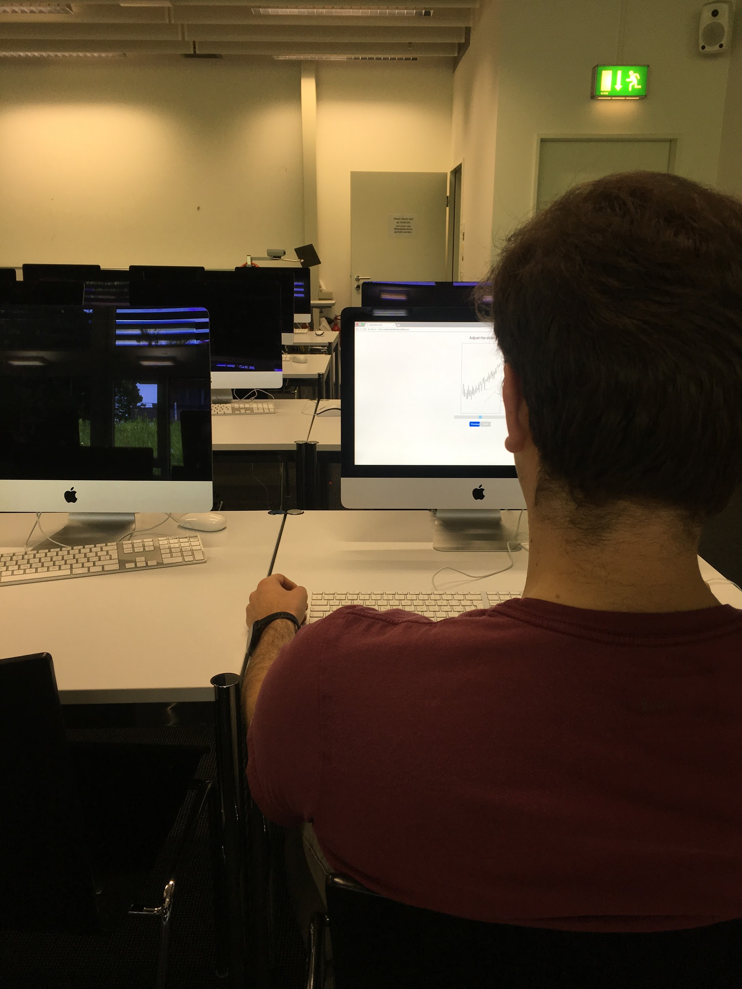
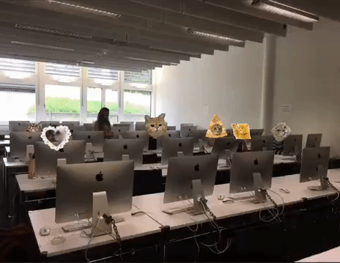
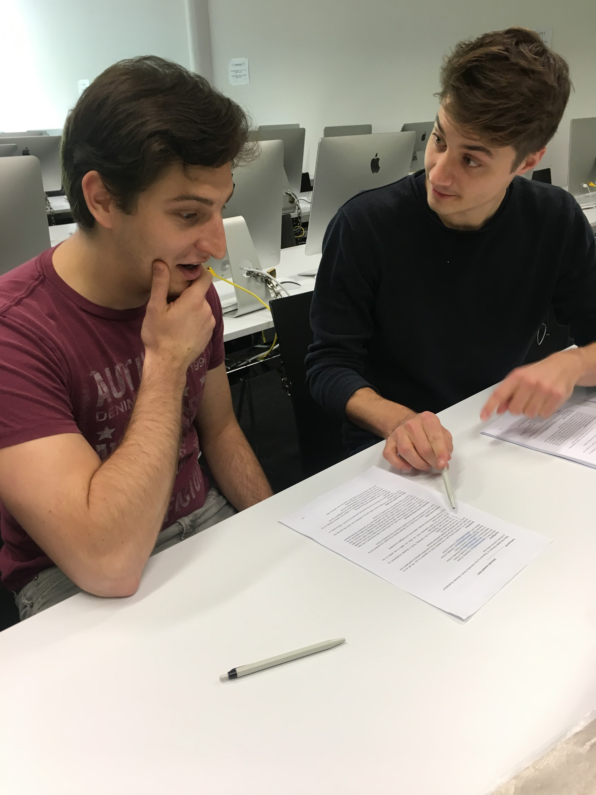
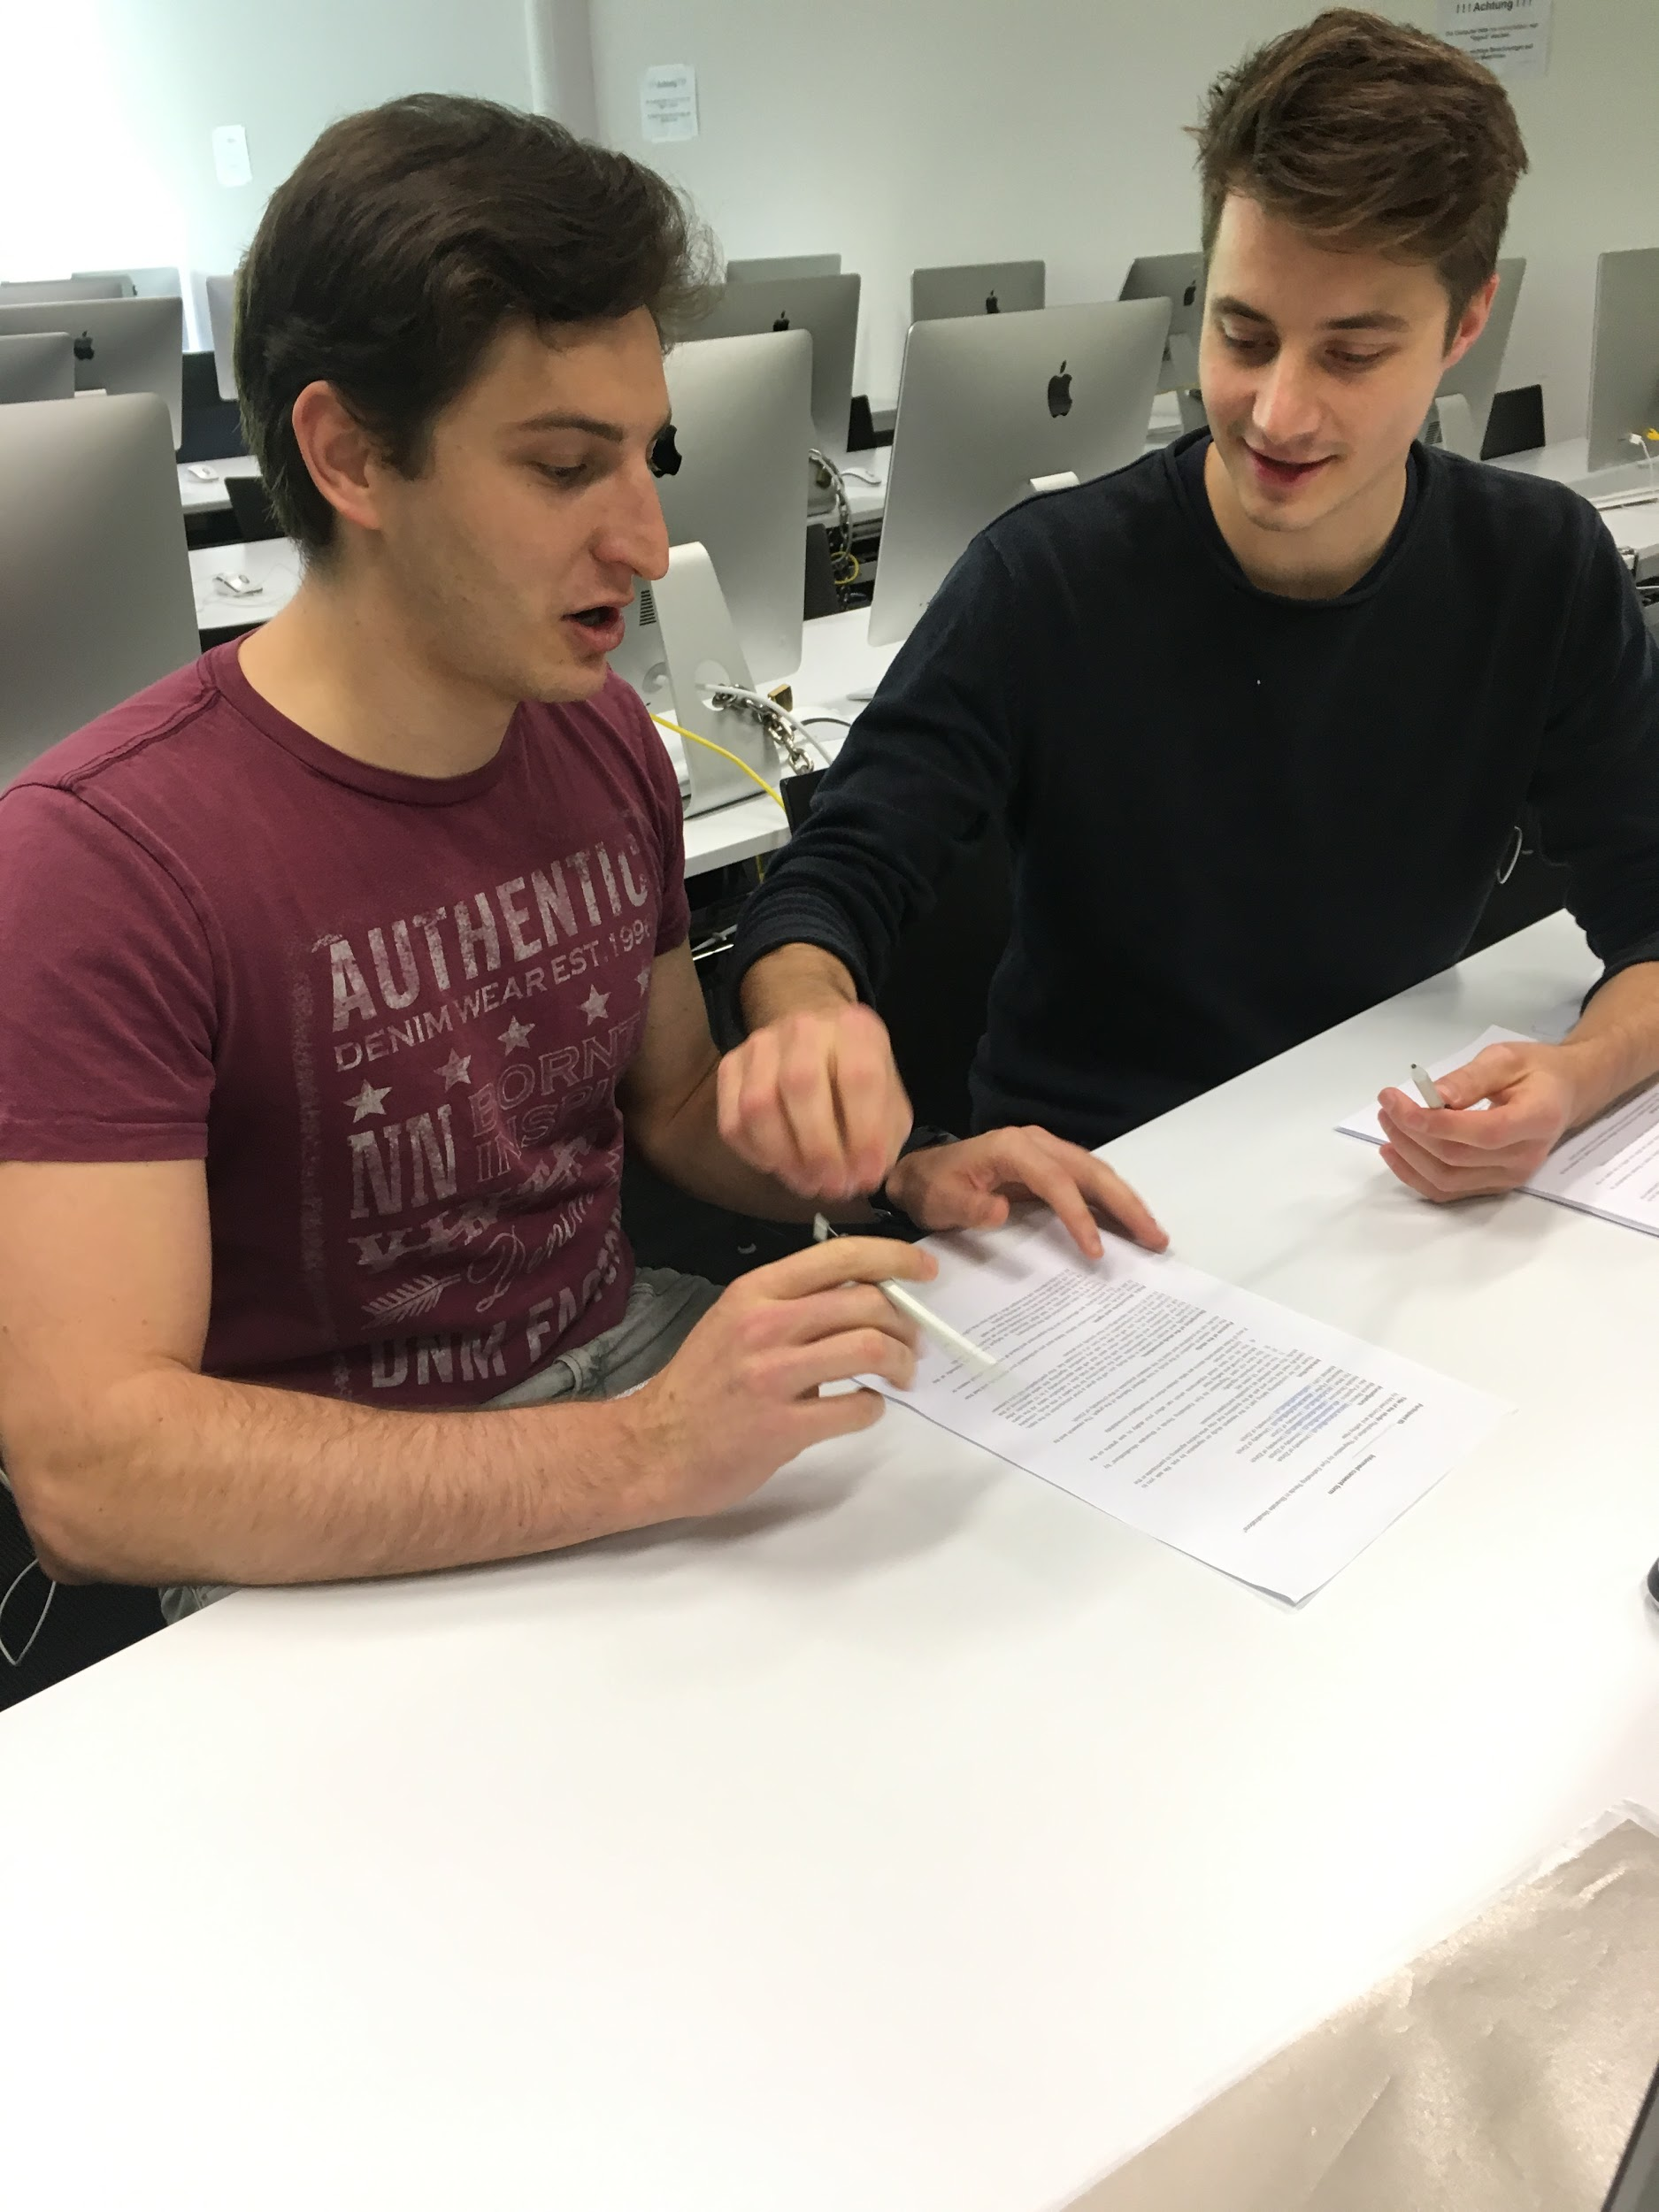
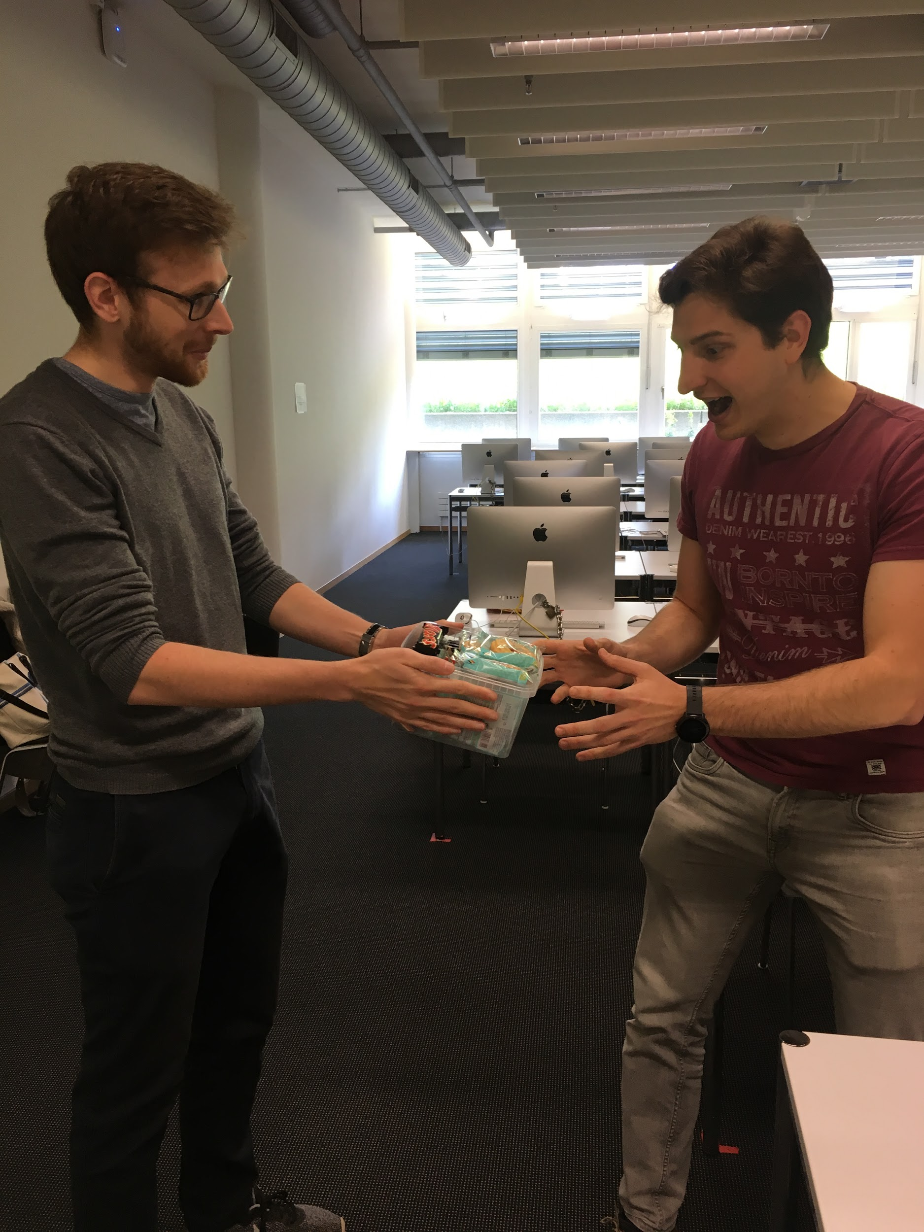
Setup
Notes:
Briefing, consent, demographics
Completing practice tasks and asking questions if any
Completing the main experiment tasks
Debriefing
Compensatiom

Slide 9
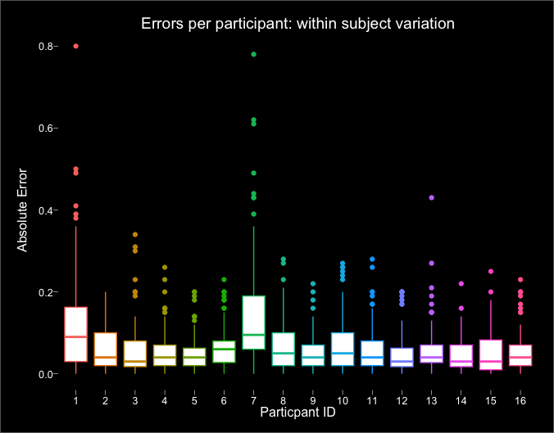
Notes:
NO exclusion from failed validation tasks
Removed outliers to check if still indentical result
Within subject variation

Slide 10
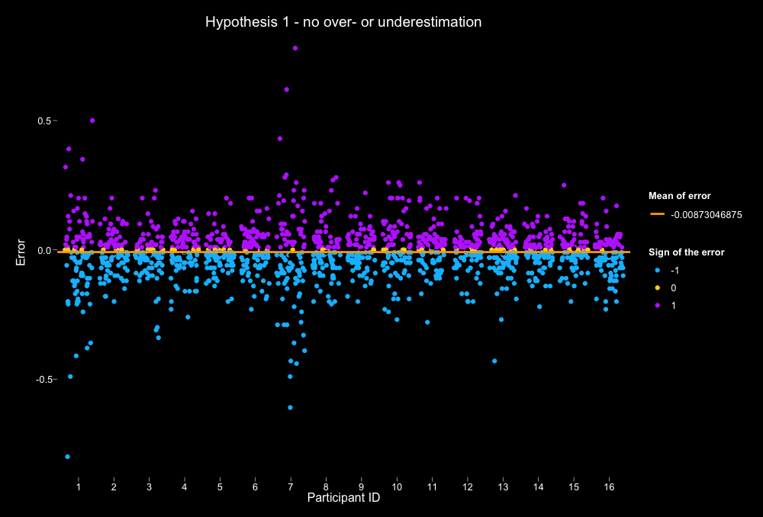
Notes:
Positive vs negative trends: can see more of a negative trend

Slide 11
H1
Graph use | T Test (mean of x, p-value)
Original Study | 0.001, p = 0.7
All participants | -0.009, p < 0.001 — undershooting
> once a month | -0.012, p < 0.001 — undershooting
< once a month | -0.002, p = 0.7
Notes:
Mainly, in the area chart.
The original study had only average errors of the participants and removed outliers
We performed a standard linear regression and found graph use to be significant at 10%, with a coefficient of -0.011.

Slide 12
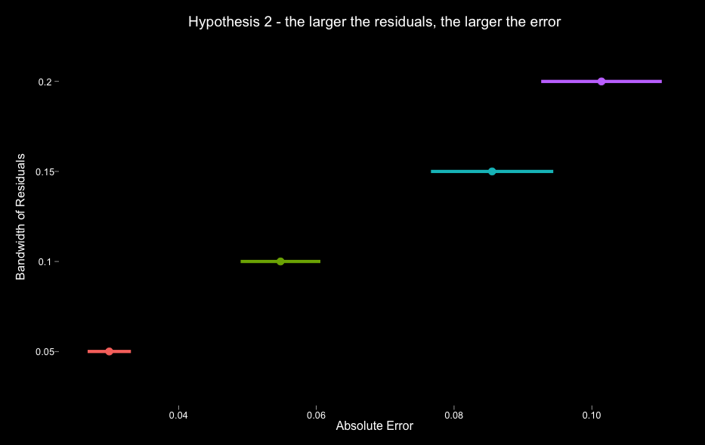
Notes:
As bandwidth of residuals increase as does the absolute error

Slide 13
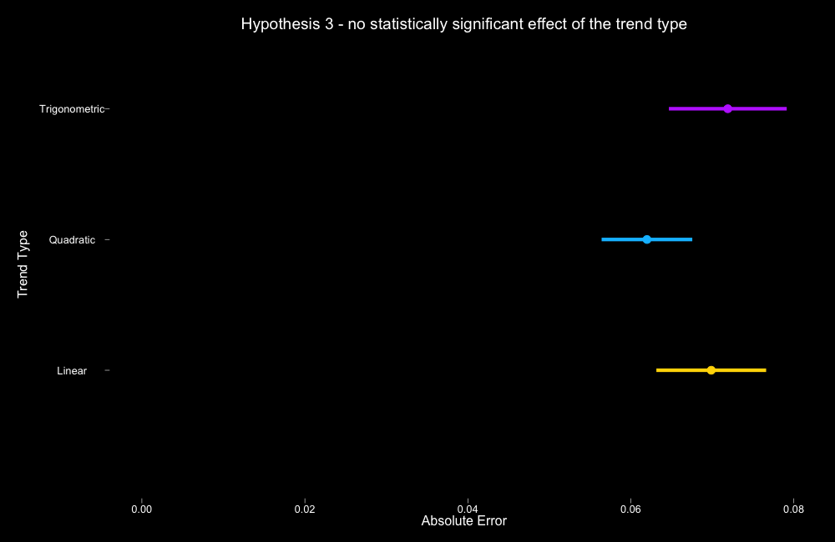
Notes:
No difference in trend type

Slide 14
Results
 | H1 | H2 | H3
Original | p = 0.7 mean = 0.0008 | p < 0.001 | p > 0.05 No pairwise interact.
Our Experiment | p < 0.001 mean = -0.0087 | p < 0.001 | p > 0.1 No pairwise interact.
Confirmed | No | Yes | Yes
Notes:
P-value: not the only source of significance, yet an appropriate one in this case as intuitive
H1: There is a significant bias between the positive and negative trends (unbalanced) Student T-Test. Signed Error. More negative trend Org H3
H2: Bandwidth (sigma) of residuals increase resulting in less accuracy Org H1
H3: No significant diff in accuracy among trend types (graphtype, should be trend) Tukey’s Honest Significant Difference Org H2
We are not using interquartile mean, since according to the authors it is only necessary for crowdsourced studies

Slide 15
Discussion
What do you think about the setup?
Any criticism toward the original paper?
What could be some causes of variation to the original study?
Notes:
First:
Second: Is it understandable? Lack of explicit details on data analysis, mainly on the regression, since unavailable to replicate the study with the same data
Third: sample differences, setting crowdsourced vs actual experiment

Slide 16
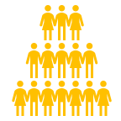
Limitations
Number of observations (48 vs. 16)
Education bias (83% vs. 100% higher educated)
Gender proportion (70-30 vs. 50-50 M-F)

Slide 17



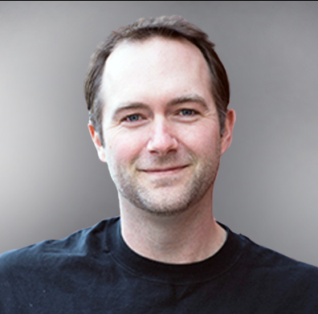
Acknowledgement
Michael Correll
Source: correl.io
Jeffrey Heer
Source: develop.touchstone2.org
Source: lecture slides
Source: acm.org
Notes:
We MUST mention that they helped us, barbarians, to understand what we are doing =)
Correl and heer for script and inspiration

Slide 18

Thank you for attention!
Do not hesitate to ask any questions!

